Slide 1
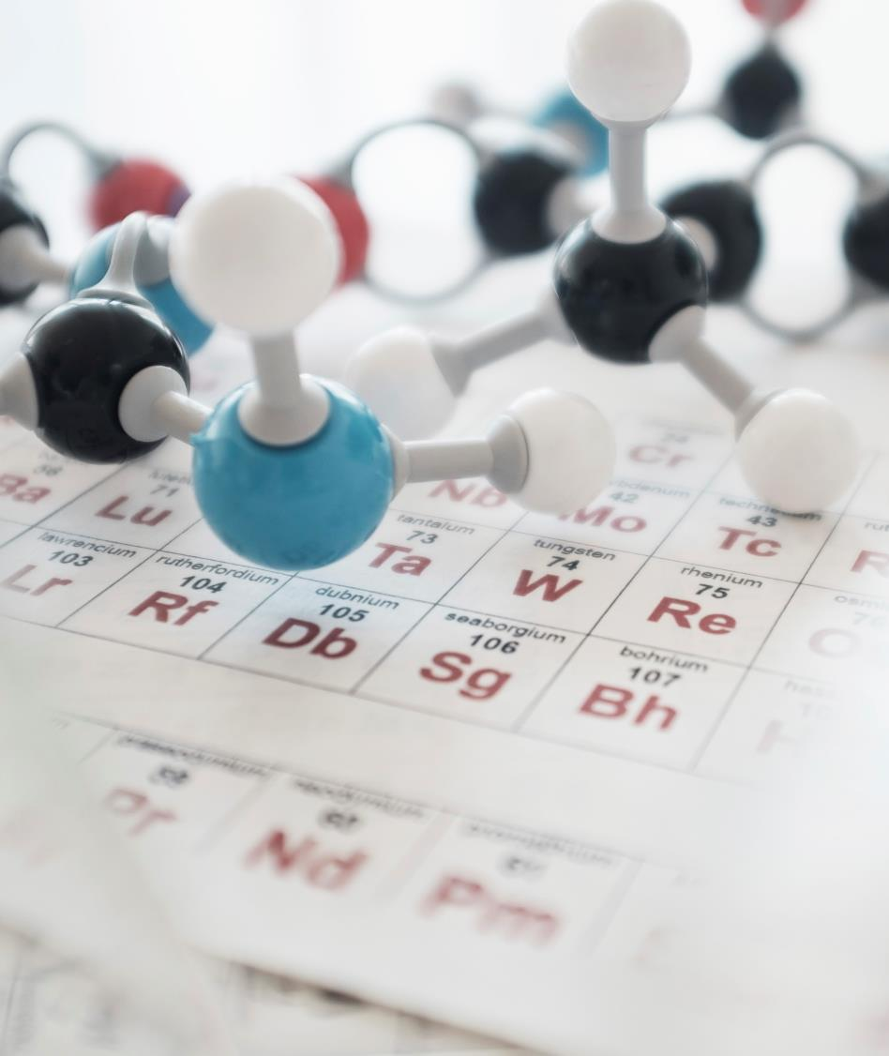
Artificial Intelligence
With Python

Slide 2
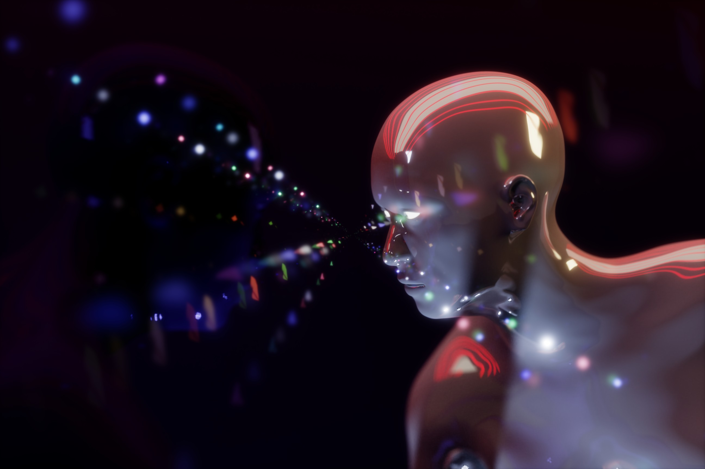
What is Artificial Intelligence (AI)?
According to the father of Artificial Intelligence, John McCarthy
→ “The science and engineering of making intelligent machines, especially intelligent computer programs”.
Artificial Intelligence is the ability to design intelligent machines or to develop self-learning software applications that imitate the traits of the human mind like reasoning, problem-solving, planning, optimal decision-making, sensory perceptions, etc.
Artificial Intelligence is a way of making a computer, a computer-controlled robot, or a software think intelligently, in the similar manner the intelligent humans think.

Slide 3
AI
Machine Learning
Deep Learning
Natural Language Processing
Artificial Neural Networks

Slide 4
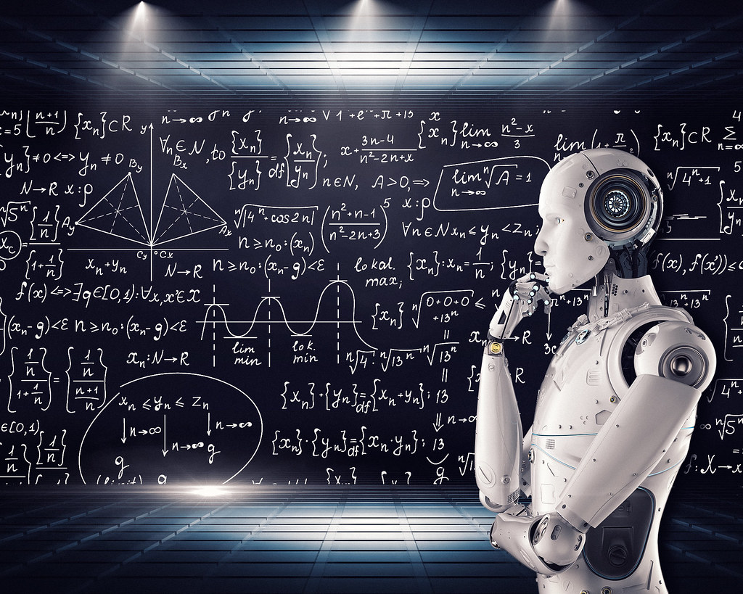
AI Machines
Can Do
Reasoning
Learning
Problem solving
Perception

Slide 5
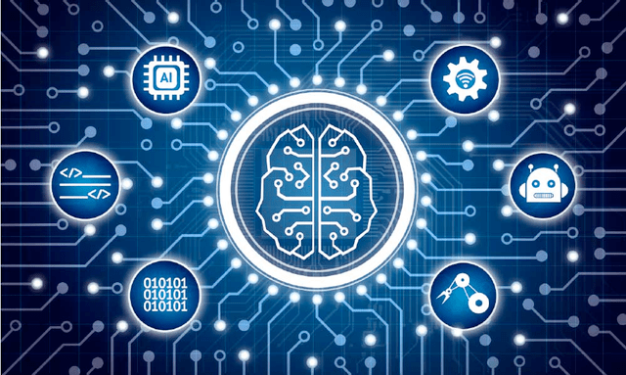
Historical development and foundation areas of
ARTIFICIAL INTELLIGENCE

Slide 6
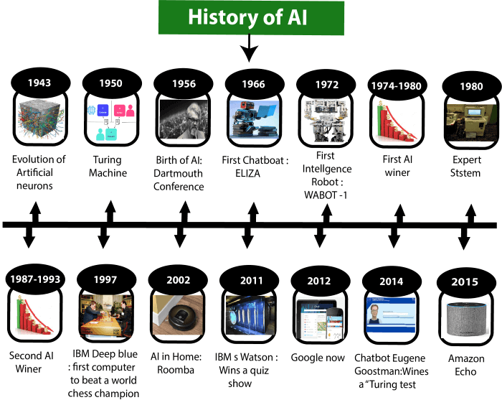
Large image
Historical Development
Notes:
History of Artificial Intelligence
Artificial Intelligence is not a new word and not a new technology for researchers. This technology is much older than you would imagine. Even there are the myths of Mechanical men in Ancient Greek and Egyptian Myths. Following are some milestones in the history of AI which defines the journey from the AI generation to till date development.
Maturation of Artificial Intelligence (1943-1952)
Year 1943: The first work which is now recognized as AI was done by Warren McCulloch and Walter pits in 1943. They proposed a model of artificial neurons.
Year 1949: Donald Hebb demonstrated an updating rule for modifying the connection strength between neurons. His rule is now called Hebbian learning.
Year 1950: The Alan Turing who was an English mathematician and pioneered Machine learning in 1950. Alan Turing publishes "Computing Machinery and Intelligence" in which he proposed a test. The test can check the machine's ability to exhibit intelligent behaviour equivalent to human intelligence, called a Turing test.
The birth of Artificial Intelligence (1952-1956)
Year 1955: An Allen Newell and Herbert A. Simon created the "first artificial intelligence program "Which was named as "Logic Theorist". This program had proved 38 of 52 Mathematics theorems, and find new and more elegant proofs for some theorems.
Year 1956: The word "Artificial Intelligence" first adopted by American Computer scientist John McCarthy at the Dartmouth Conference. For the first time, AI coined as an academic field.
At that time high-level computer languages such as FORTRAN, LISP, or COBOL were invented. And the enthusiasm for AI was very high at that time.
The golden years-Early enthusiasm (1956-1974)
Year 1966: The researchers emphasized developing algorithms which can solve mathematical problems. Joseph Weinbaum created the first chatbot in 1966, which was named as ELIZA.
Year 1972: The first intelligent humanoid robot was built in Japan which was named as WABOT-1.
The first AI winter (1974-1980)
The duration between years 1974 to 1980 was the first AI winter duration. AI winter refers to the time period where computer scientist dealt with a severe shortage of funding from government for AI researches.
During AI winters, an interest of publicity on artificial intelligence was decreased.
A boom of AI (1980-1987)
Year 1980: After AI winter duration, AI came back with "Expert System". Expert systems were programmed that emulate the decision-making ability of a human expert.
In the Year 1980, the first national conference of the American Association of Artificial Intelligence was held at Stanford University.
The second AI winter (1987-1993)
The duration between the years 1987 to 1993 was the second AI Winter duration.
Again Investors and government stopped in funding for AI research as due to high cost but not efficient result. The expert system such as XCON was very cost effective.
The emergence of intelligent agents (1993-2011)
Year 1997: In the year 1997, IBM Deep Blue beats world chess champion, Gary Kasparov, and became the first computer to beat a world chess champion.
Year 2002: for the first time, AI entered the home in the form of Roomba, a vacuum cleaner.
Year 2006: AI came in the Business world till the year 2006. Companies like Facebook, Twitter, and Netflix also started using AI.
Deep learning, big data and artificial general intelligence (2011-present)
Year 2011: In the year 2011, IBM's Watson won jeopardy, a quiz show, where it had to solve the complex questions as well as riddles. Watson had proved that it could understand natural language and can solve tricky questions quickly.
Year 2012: Google has launched an Android app feature "Google now", which was able to provide information to the user as a prediction.
Year 2014: In the year 2014, Chatbot "Eugene Goostman" won a competition in the infamous "Turing test."
Year 2018: The "Project Debater" from IBM debated on complex topics with two master debaters and also performed extremely well.
Google has demonstrated an AI program "Duplex" which was a virtual assistant and which had taken hairdresser appointment on call, and lady on other side didn't notice that she was talking with the machine.
Now AI has developed to a remarkable level. The concept of Deep learning, big data, and data science are now trending like a boom. Nowadays companies like Google, Facebook, IBM, and Amazon are working with AI and creating amazing devices. The future of Artificial Intelligence is inspiring and will come with high intelligence.
video link :- https://youtu.be/lnO7hmD6qzo?si=v3Cw1w7X-yygy4mH

Slide 7
Foundation Areas In Artificial Intelligence
AI
CORE
Machine Learning (ML)
Neural Networks and Deep Learning:
Natural Language Processing (NLP):
Computer Vision:
Reinforcement Learning:
Knowledge Representation and Reasoning:
Ethics and Bias in AI:
Symbolic AI and Expert Systems:
Data Science:
Notes:
Machine Learning (ML):
Definition: Machine learning is a subset of AI that focuses on the development of algorithms and statistical models that enable computers to improve their performance on a task without being explicitly programmed.
Importance: ML is the backbone of many AI applications, allowing systems to learn patterns, make predictions, and adapt to new data.
Neural Networks and Deep Learning:
Definition: Neural networks are computational models inspired by the structure and functioning of the human brain. Deep learning is a subfield of ML that uses neural networks with multiple layers (deep neural networks) to model complex patterns.
Importance: Deep learning has led to breakthroughs in tasks like image recognition, natural language processing, and game playing.
Natural Language Processing (NLP):
Definition: NLP involves the interaction between computers and human language. It includes tasks such as language understanding, sentiment analysis, and language generation.
Importance: NLP is crucial for developing applications like chatbots, language translation, and voice recognition systems.
Computer Vision:
Definition: Computer vision focuses on enabling machines to interpret and understand visual information from the world, such as images and videos.
Importance: Computer vision is applied in facial recognition, object detection, autonomous vehicles, and medical image analysis.
Reinforcement Learning:
Definition: Reinforcement learning involves training machines to make sequences of decisions by providing feedback in the form of rewards or punishments.
Importance: Reinforcement learning is used in applications like game playing, robotic control, and optimization problems.
Knowledge Representation and Reasoning:
Definition: This area deals with how to represent information about the world in a form that a computer system can utilize to solve complex tasks.
Importance: Effective knowledge representation is crucial for systems to reason, plan, and make informed decisions.
Ethics and Bias in AI:
Definition: The ethical considerations and potential biases in AI systems, including issues related to fairness, transparency, and accountability.
Importance: Addressing ethical concerns and mitigating biases is crucial to ensure responsible and equitable AI development and deployment.
Symbolic AI and Expert Systems:
Definition: Symbolic AI involves the use of symbols and rules to represent knowledge and perform logical reasoning. Expert systems are AI programs designed to emulate the decision-making ability of a human expert.
Importance: Symbolic AI and expert systems were foundational in the early development of AI and are still relevant in certain applications.
Data Science:
Definition: Data science involves extracting knowledge and insights from large datasets, often using statistical methods and machine learning techniques.
Importance: High-quality data and effective data analysis are essential for training and evaluating AI models.

Slide 8

Tasks And Application Areas Of Artificial Intelligence
Computer Vision:
Machine Learning:
Robotics:
Expert Systems:
Finance:
Education:
Cybersecurity:
Natural Language Processing (NLP):
Reinforcement Learning:
Healthcare:
.
Notes:
Artificial Intelligence (AI) has a wide range of tasks and applications across various domains. Here are some common tasks and application areas of AI:
1. Natural Language Processing (NLP):
Tasks:
Speech Recognition: Converting spoken language into written text.
Text Generation: Creating human-like text based on input data.
Sentiment Analysis: Determining the sentiment behind a piece of text (positive, negative, neutral).
Applications:
Virtual Assistants (e.g., Siri, Alexa, Google Assistant).
Chatbots for customer support.
Language translation services.
2. Computer Vision:
Tasks:
Image Recognition: Identifying objects, people, or scenes in images.
Object Detection: Locating and classifying objects within images or videos.
Facial Recognition: Identifying and verifying individuals based on facial features.
Applications:
Autonomous vehicles (e.g., self-driving cars).
Surveillance systems.
Medical image analysis.
3. Machine Learning:
Tasks:
Classification: Assigning labels to data based on patterns.
Regression: Predicting numerical values based on input data.
Clustering: Grouping similar data points together.
Applications:
Predictive maintenance in manufacturing.
Fraud detection in finance.
Recommendation systems in e-commerce.
4. Robotics:
Tasks:
Motion Planning: Planning the movements of robots in various environments.
Object Manipulation: Grasping and manipulating objects.
Autonomous Navigation: Navigating in unknown or dynamic environments.
Applications:
Industrial automation.
Surgical robots.
Unmanned aerial vehicles (UAVs).
5. Expert Systems:
Tasks:
Knowledge Representation: Representing information about the world.
Inference: Drawing logical conclusions based on available information.
Applications:
Medical diagnosis.
Financial decision-making.
Troubleshooting in technical systems.
6. Reinforcement Learning:
Tasks:
Decision Making: Making a sequence of decisions to achieve a goal.
Game Playing: Learning to play and excel in games.
Applications:
Game-playing agents (e.g., AlphaGo).
Robotics control.
7. AI in Healthcare:
Tasks:
Diagnosis: Identifying diseases based on symptoms and medical data.
Drug Discovery: Analyzing biological data to discover new drugs.
Applications:
Personalized medicine.
Medical image analysis.
8. AI in Finance:
Tasks:
Algorithmic Trading: Using AI to make trading decisions.
Credit Scoring: Assessing the creditworthiness of individuals.
Applications:
Risk management.
Fraud detection.
9. AI in Education:
Tasks:
Adaptive Learning: Personalizing educational content based on individual progress.
Automated Grading: Grading assignments and exams using AI.
Applications:
Intelligent tutoring systems.
Educational games.
10. AI in Cybersecurity:
Tasks:
Anomaly Detection: Identifying unusual patterns in network traffic.
Threat Intelligence: Analyzing data to identify potential security threats.
Applications:
Intrusion detection systems.
Malware detection.

Slide 9
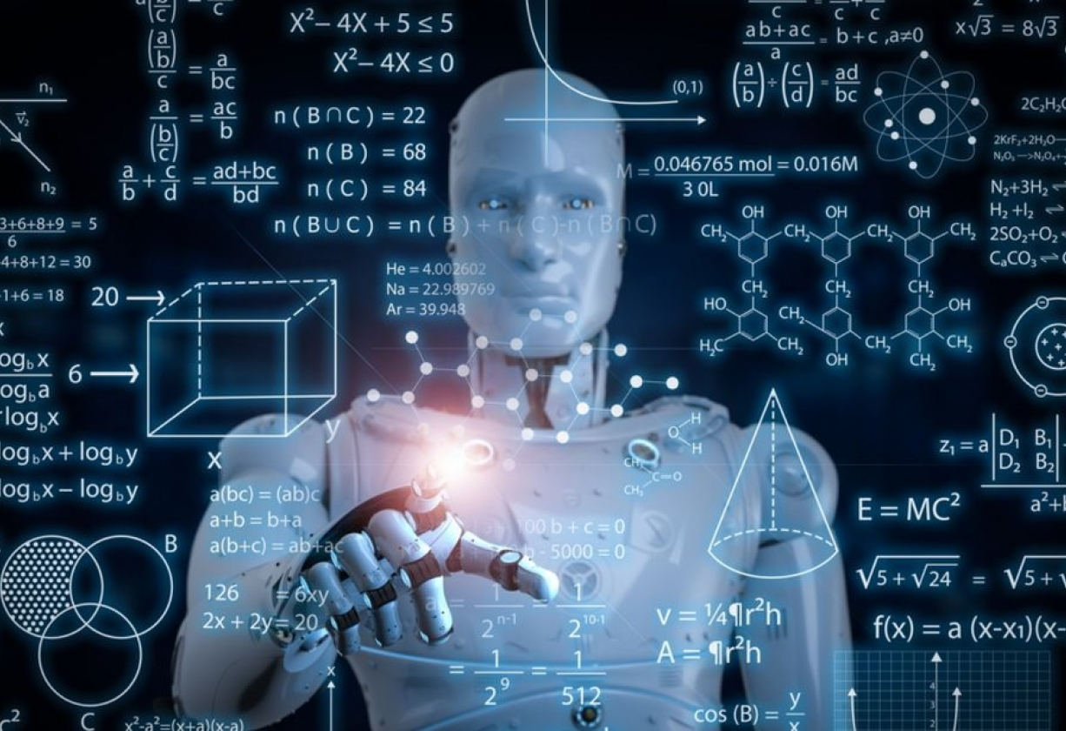
AI Around Us
Chatbots such as ChatGPT, GPT-4, Claude, etc.
Personalized recommendations on streaming services like Netflix,
Spotify, YouTube, etc.
Voice assistants like Siri, Alexa, and Google Assistant
Fraud detection in banking and finance
Social media algorithms that curate your feed
Spam filters in email
Predictive text on your smartphone keyboard
Smart home systems that adjust to your preferences
Virtual personal shopping assistants
Medical diagnosis and treatment planning
Examples:-

Slide 10
Why you should learn
Motivation
A1/ML course?
Safeguard your career.
Solve complex problems.
Stay informed about the current technologies
Solve domain problems with the power of machines
Use machines to avoid monotonous or humanly impossible tasks

Slide 11
Structure of Intelligent Agents:
Perception Module:
Function: Receives and interprets information from the environment.
Knowledge Base:
Components: Sensors, cameras, microphones, or other means of collecting data.
Function: Represents the internal model of the world, storing information about the environment.
Components: Memory or database where the agent stores information.
Reasoning/Decision-Making Module:
Function: Processes information from the perception module and the knowledge base to make decisions.
Components: Algorithms, rules, or logic systems for decision-making.
Action Module:
Function: Executes chosen actions in the environment.
Components: Actuators, motors, or other mechanisms for interacting with the external world.
Learning Module (in Learning Agents):
Function: Adapts the knowledge base based on feedback and experiences, improving the agent's performance.
Components: Machine learning algorithms, training data, or reinforcement learning mechanisms.

Slide 12
Structure of Intelligent Agents
Perception / sensors
Environment / change
Effectors / actuator(action)
Agent / Agent program
Goals
Of
Agent
High Performance
Optimized Result
Rational Action Right

Slide 13
Structure of Intelligent Agents
P. E. A. S.
Performance
Environment
Actions
Sensors
Agent
Percept
Decision
Action

Slide 14
Types of Intelligent Agents:
Simple Reflex Agents:
Description: Reacts to the current percept (sensory input) without considering the history or having an internal state.
Example: A thermostat that turns on the heating when the temperature falls below a certain level.
Model-Based Reflex Agents:
Description: Maintains an internal model of the environment and considers the current percept along with past percepts.
Example: A chess-playing program that remembers past moves to make decisions.
Goal-Based Agents:
Description: Operates by selecting actions that lead to states considered desirable or goal states.
Example: An autonomous vehicle navigating through traffic to reach a destination.
Utility-Based Agents:
Description: Evaluates actions based on a utility function, considering the desirability of outcomes.
Example: A smart home system that adjusts heating, lighting, and other parameters to maximize user comfort.
Learning Agents:
Description: Adapts and improves its performance over time through learning from experience.
Example: An email spam filter that learns to identify spam based on user feedback.
Perception-Based Agents:
Description: Focuses on interpreting and understanding sensory input from the environment.
Example: Image recognition software that identifies objects in pictures.
Robotic Agents:
Description: Physical agents that operate in the real world, taking actions and perceiving through sensors.
Example: A robot vacuum cleaner that navigates a room, avoiding obstacles, and cleaning.

Slide 15
Computer Vision for AI
Image Acquisition:
Definition: The process of obtaining images or video frames from cameras or other sources.
Importance: High-quality image acquisition is essential for accurate computer vision analysis.
Image Preprocessing:
Definition: Techniques to enhance or clean up raw images before analysis.
Examples: Image resizing, normalization, and noise reduction.
Feature Extraction:
Definition: Identifying and extracting relevant features from images, such as edges, corners, or textures.
Importance: Features serve as the basis for higher-level analysis and object recognition.
Image Recognition:
Definition: The process of identifying and categorizing objects or patterns within an image.
Examples: Object detection, classification, and scene understanding.
Object Detection:
Definition: Locating and identifying multiple objects within an image or video frame.
Techniques: Region-based CNNs, YOLO (You Only Look Once), and SSD (Single Shot Multibox Detector).
Image Segmentation:
Definition: Dividing an image into segments to identify and analyze individual objects or regions.
Importance: Helps in understanding the spatial distribution of objects in an image.
Pose Estimation:
Definition: Determining the position and orientation of objects or people within an image or 3D space.
Applications: Robotics, augmented reality, and human-computer interaction.
Feature Matching:
Definition: Comparing and matching features between different images.
Applications: Image stitching, object tracking, and image retrieval.
Deep Learning in Computer Vision:
Definition: Using deep neural networks for complex visual tasks.
Techniques: Convolutional Neural Networks (CNNs) are widely used for image classification and object detection.
3D Computer Vision:
Definition: Extending computer vision to analyze and interpret three-dimensional data.
Applications: 3D object recognition, depth estimation, and 3D reconstruction.
Medical Image Analysis:
Applications: Diagnosing diseases through techniques like tumor detection in medical images.
Video Analysis:
Applications: Action recognition, tracking moving objects, and video surveillance.

Slide 16
Applications of Computer Vision:
Autonomous Vehicles:
Computer vision is crucial for tasks like lane detection, object recognition, and pedestrian tracking.
Surveillance Systems:
Image and video analysis for security and monitoring purposes.
Augmented Reality:
Overlaying digital information on the real-world view through computer vision.
Healthcare:
Medical imaging, pathology analysis, and surgery assistance.
Retail:
Object recognition for inventory management, customer tracking, and cashierless stores.
Manufacturing:
Quality control, defect detection, and process optimization using computer vision.
Robotics:
Vision systems for robotic navigation, object manipulation, and assembly.
Facial Recognition:
Security, authentication, and emotion analysis.
Human-Computer Interaction:
Gesture recognition, facial expression analysis, and gaze tracking.

Slide 17
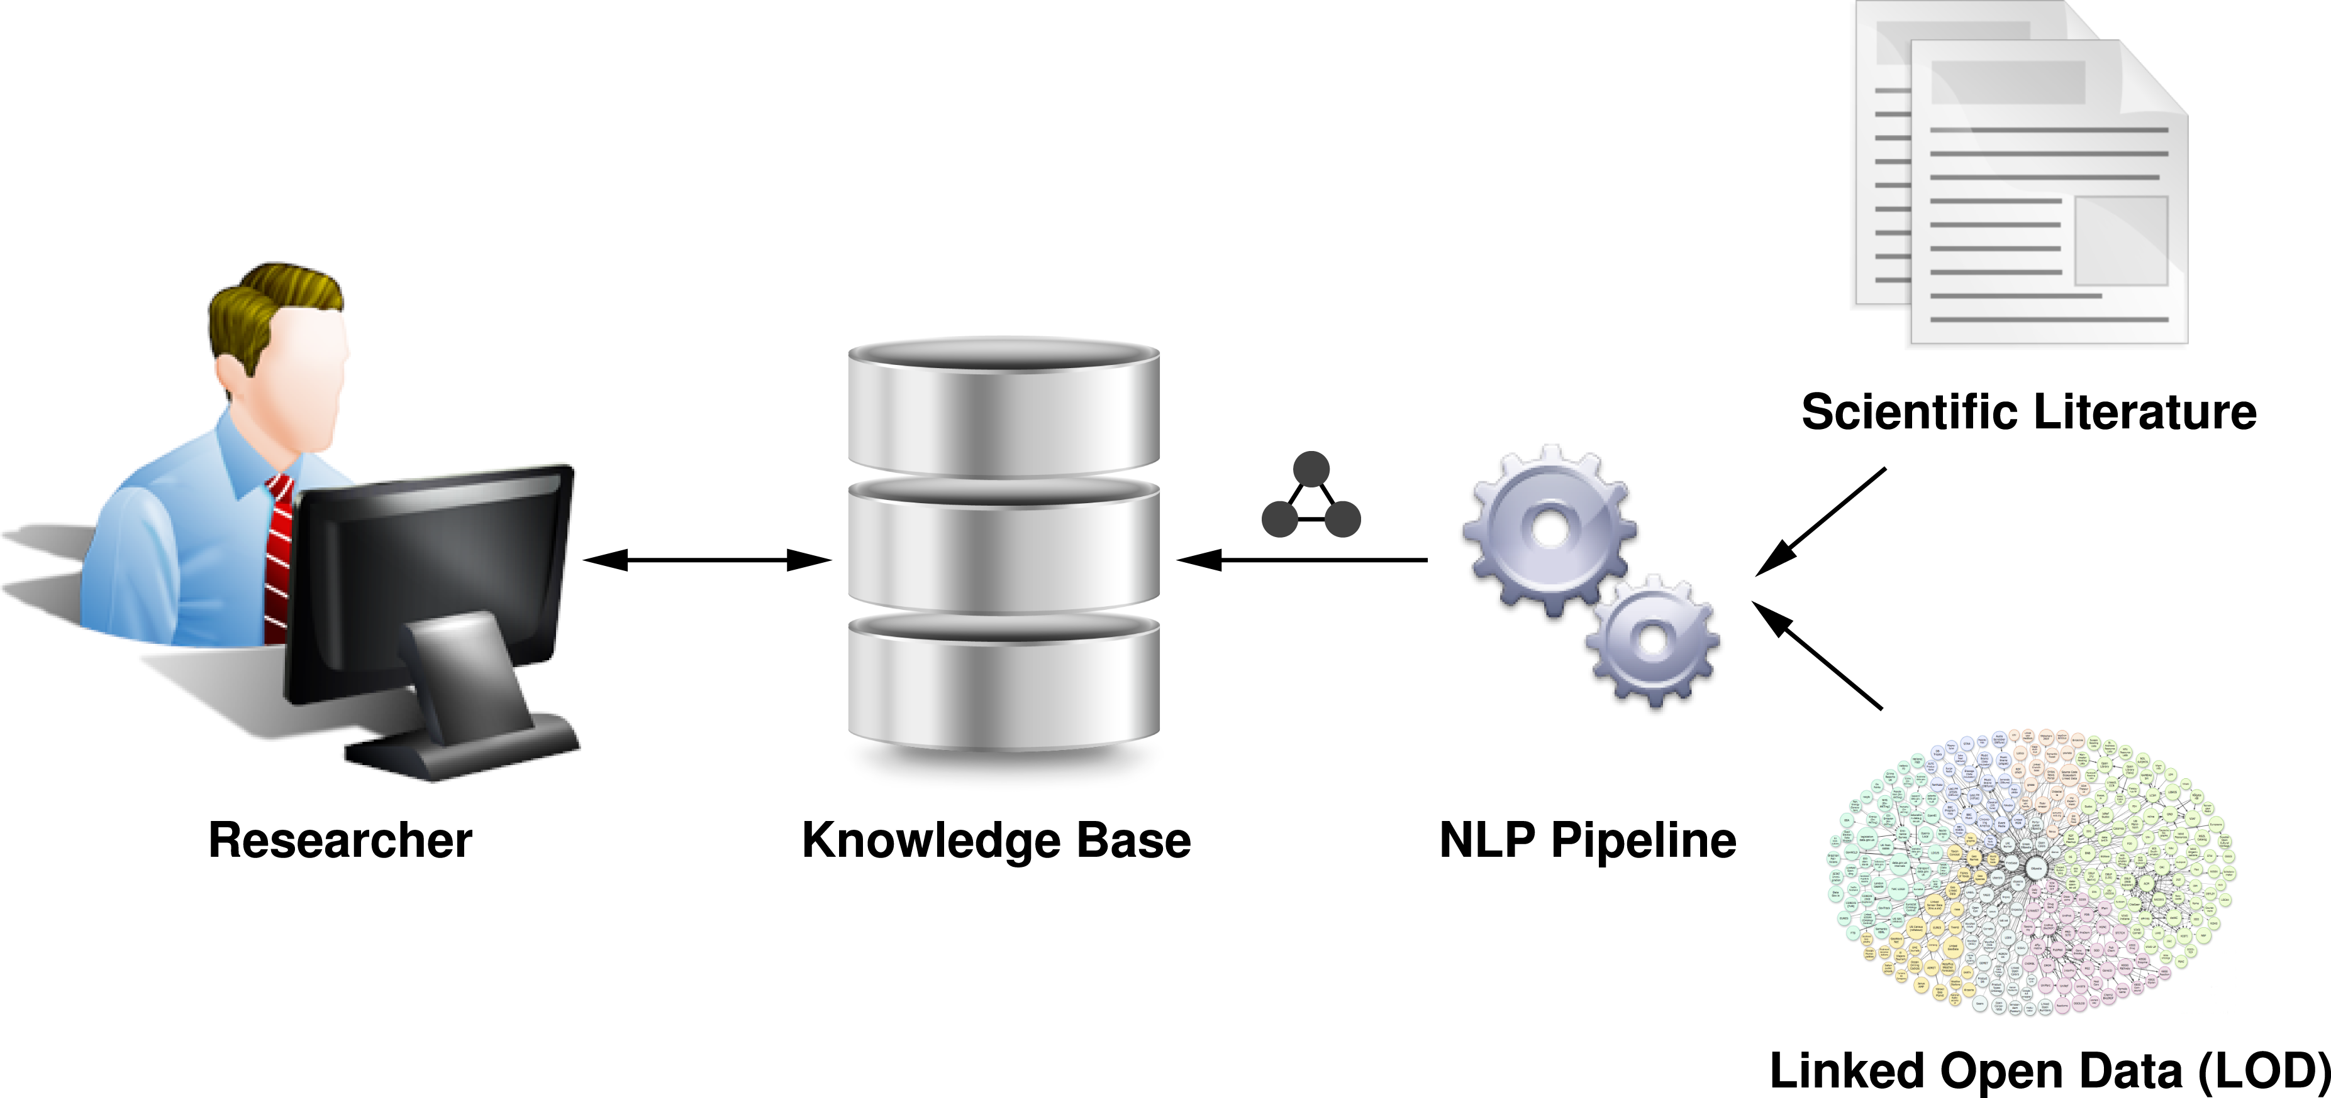
Natural Language Processing (NLP):
Natural Language Processing is a field of artificial intelligence that focuses on the interaction between computers and humans using natural language. The goal of NLP is to enable machines to understand, interpret, and generate human-like language, both in written and spoken forms. NLP involves a range of tasks and applications that make it possible for computers to work with text and speech data in a way that is both meaningful and contextually relevant.

Slide 18
Key Concepts and Techniques in Natural Language Processing:
Tokenization:
Definition: Breaking down a text into smaller units, such as words or sentences.
Importance: Facilitates analysis and understanding of text by identifying individual elements.
Part-of-Speech Tagging:
Definition: Assigning grammatical categories (e.g., nouns, verbs, adjectives) to words in a sentence.
Applications: Helps in syntactic analysis and understanding the structure of sentences.
Named Entity Recognition (NER):
Definition: Identifying and classifying named entities (e.g., persons, organizations, locations) in text.
Applications: Information extraction, entity linking, and question answering.
Syntax and Parsing:
Definition: Analyzing the grammatical structure of sentences to understand their syntactic relationships.
Importance: Helps in constructing a meaningful representation of the text.
Semantic Analysis:
Definition: Understanding the meaning of words, phrases, and sentences in a given context.
Applications: Sentiment analysis, text summarization, and question answering.
Word Embeddings:
Definition: Representing words as vectors in a continuous vector space.
Techniques: Word2Vec, GloVe, and FastText.
Applications: Improves semantic representation and similarity analysis.
Machine Translation:
Definition: Automatically translating text from one language to another.
Applications: Google Translate, language localization in software.
Speech Recognition:
Definition: Converting spoken language into written text.
Applications: Virtual assistants (e.g., Siri, Alexa), transcription services.
Text Classification:
Definition: Assigning predefined categories or labels to text documents.
Applications: Spam detection, sentiment analysis, topic categorization.
Question Answering:
Definition: Systems that understand and answer questions posed in natural language.
Applications: Chatbots, virtual assistants, information retrieval.
Dialogue Systems:
Definition: Systems capable of engaging in conversations with users in natural language.
Applications: Customer support chatbots, virtual assistants.
Summarization:
Definition: Creating concise representations of larger texts while retaining essential information.
Applications: News summarization, document summarization.

Slide 19
Applications of Natural Language Processing:
Search Engines:
Enhances search query understanding and improves search results.
Virtual Assistants:
Powers conversational interfaces for virtual assistants like Siri, Alexa, and Google Assistant.
Sentiment Analysis:
Analyzes and determines the sentiment expressed in textual content (positive, negative, neutral).
Chatbots:
Enables automated responses and interactions in natural language.
Language Translation:
Facilitates the translation of text from one language to another.
Information Extraction:
Extracts structured information from unstructured text.
Healthcare Informatics:
Analyzes clinical notes, research papers, and patient records for valuable insights.
Finance:
Automates the analysis of financial reports, news, and market trends.
Legal:
Assists in legal document analysis, contract review, and information retrieval.
Social Media Analysis:
Monitors and analyzes social media content for trends and sentiments.

Slide 20

Thank You
Jens Martensson
jens@bellowscollege.com

